Slide 1


Dr. N.G.P. INSTITUTE OF TECHNOLOGY
Coimbatore - 48
(An Autonomous Institution)
DEPARTMENT OF INFORMATION TECHNOLOGY
CLASSIFYING DEPRESSION USING MACHINE LEARNING ON SOCIAL MEDIA TWEETS
Guided By
Mrs. BIJI ROSE .M.E,
Assistant Professor (SG)/IT
Team Members
BIPIN.V.K (710719205010)
CRIS CUMINS.P (710719205012)
WILSON.A (710719205058)

Slide 2
OUTLINE
Objective
Literature Survey
Findings from Literature Survey
Problem Statement
Existing Techniques
Proposed Methods
Hardware & Software Specifications
Block Diagram
Performance Parameters
Conclusion
Future Scope
Publication
References
12/04/23
Classifying depression using machine learning on social media tweets

Slide 3
OBJECTIVE
To investigate the potential of social media as a tool for analyzing the sentiment and emotional tone of tweets using machine learning for identifying people with depression.
12/04/23
Classifying depression using machine learning on social media tweets

Slide 4
LITERATURE SURVEY
S. No. | Title of the Paper | Author Details | Publication & Year | Remarks
1. | Depression Classification From Tweets Using Small Deep Transfer Learning Language Models | M. Rizwan, M. F. Mushtaq, U. Akram, A. Mehmood, I. Ashraf and B. Sahelices | IEEE Access & 2022 | - transformer language models - F1 score of 87%
2. | Detecting Community Depression Dynamics Due to COVID-19 Pandemic in Australia | J. Zhou, H. Zogan, S. Yang, S. Jameel, G. Xu and F. Chen | IEEE Access & 2021 | - COVID-19 - multimodal features - F1 score of 87.9%
3. | Sentiment Classification on Twitter and Zomato Dataset Using Supervised Learning Algorithms | Kai Liu , Xi Zhang and Yang Quan Chen | IEEE Access & 2020 | - Geometric features. - Deep learning algorithms - Highest accuracy – 88%
4. | Predicting Depression in Canada by Automatic Filling of Beck’s Depression Inventory Questionnaire | R. S. Skaik and D. Inkpen, | IEEE Access & 2022 | - beck depression inventory - eRisk 2021 - accuracy of 82.5%
5. | Automatic detection of depression symptoms in twitter using multimodal analysis | Safa, R., Bayat, P. & Moghtader, L. | Springer & 2021 | - Multimodal framework - Text mining - accuracy of 83%

Slide 5
LITERATURE SURVEY
S. No. | Title of the Paper | Author Details | Publication & Year | Remarks
6. | Psychological Analysis for Depression Detection from Social Networking Sites | Sonam Gupta , 1 Lipika Goel , 2 Arjun Singh , 3 Ajay Prasad , 4 and Mohammad Aman Ullah | Hindawi & 2022 | -machine learning classifiers -Accuracy: 72%
7. | Detection of Depression-Related Posts in Reddit Social Media Forum | M. M. Tadesse, H. Lin, B. Xu and L. Yang | IEEE Access 7 & 2019 | -machine learning -Accuracy:80% -F1 score-0.80
8. | Deep Sentiment Analysis of Twitter Data Using a Hybrid Ghost Convolution Neural Network Model | Mohammed Hasan Ali Al-Abyadh, Mohamed A. M. Iesa Mohamed Abdulamir, Asadullah Jalali | Hindawi & 2022 | -convolution neural network (CNN) -SVM models -70% accuracy
9. | Improving the Performance of Sentiment Analysis of Tweets Containing Fuzzy Sentiment Using the Feature Ensemble Model | H. T. Phan, V. C. Tran, N. T. Nguyen and D. Hwang | IEEE Access 8 & 2020 | -Feature ensemble model -fuzzy sentiment
10. | Enhancing EEG-Based Classification of Depression Patients Using Spatial Information | Jiang C, Li Y, Tang Y, Guan C | IEEE Transactions & 2021 | EEG classification Accuracy-83.2% mood disease

Slide 6
FINDINGS FROM LITERATURE SURVEY
Novel classification model can be used to extract depression polarities and determine depression levels from user-generated content on Twitter.
Supervised Machine Learning Classifications are used in Twitter datasets to detect and analyze people's feelings of depression.
Natural Language Processing (NLP) techniques and Machine Learning identifies depression attitudes, revealing a lexicon of terms related to depression.
Random Forest can detect depression using demographic characteristics and text sentiment of Twitter users to reduce depression-induced suicide rates.
12/04/23
Classifying depression using machine learning on social media tweets

Slide 7
PROBLEM STATEMENT
The lack of explicit detection of psychological depression using machine learning algorithms is a challenge in computational psychology studies, where the relationship between depression and emotions is crucial to understanding human behavior.
12/04/23
Classifying depression using machine learning on social media tweets

Slide 8
EXISTING TECHNIQUES
Existing Depression detectors are inconvenient for long-term use as they require dedicated devices or extensive user interaction for adaptation.
Bidirectional Encoder Representations from Transformers has been used for sentiment analysis, deep contextualized embedding, and deep transfer learning for specific task
Several existing systems use machine learning to classify depression from social media tweets, including models based on supervised learning, NLP techniques, and sentiment analysis.
12/04/23
Classifying depression using machine learning on social media tweets

Slide 9
PROPOSED METHODS
The proposed method for this project involves using a machine learning data classification system that utilizes both SVM and KNN algorithms to classify data related to psychological depression.
The system will be trained on a dataset of labelled data and will be validated using experimental data to ensure accurate results. The ultimate goal is to develop a reliable and accurate system that can assist in the detection and management of Depression.
12/04/23
Classifying depression using machine learning on social media tweets

Slide 10
PROPOSED METHODS
MODULE DESCRIPTION
PRE-PROCESSING
MODEL SELECTION
EVALUATION METRICS
GENERALIZATION
12/04/23
Classifying depression using machine learning on social media tweets

Slide 11
PRE-PROCESSING
Preprocessing data for machine learning includes cleaning, handling missing values, and normalizing features. Careful selection of relevant features is crucial for optimal model performance.
MODEL SELECTION
Evaluating each model's performance on the testing set is crucial for selecting the best one. SVM and KNN are popular machine learning algorithms that can be used for depression detection.
12/04/23
Classifying depression using machine learning on social media tweets

Slide 12
EVALUATION METRICS
When evaluating the performance of the models, it is important to consider multiple metrics. These metrics can help provide a more comprehensive evaluation of the models' performance, particularly when dealing with imbalanced datasets.
GENERALIZATION
It is important to ensure that the models can generalize to new, unseen data. This can be achieved by using techniques such as cross-validation, regularization, and data augmentation. It is also important to test the models on data from different sources to ensure that they can generalize to different populations.
12/04/23
Classifying depression using machine learning on social media tweets

Slide 13
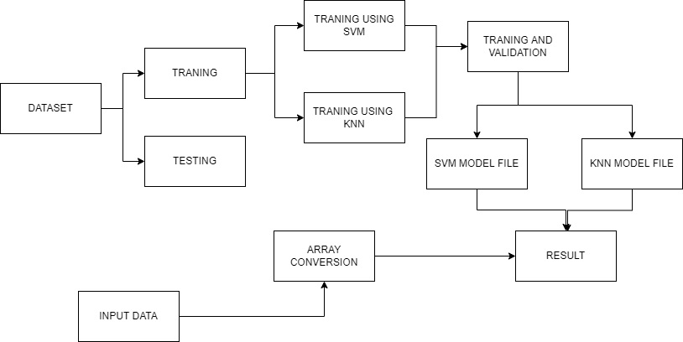
BLOCK DIAGRAM
12/04/23
Classifying depression using machine learning on social media tweets

Slide 14
HARDWARE & SOFTWARE SPECIFICATIONS
This section gives the details and specification of the hardware on which the system is expected to work.
Processor : AMD Ryzen
RAM : 8 GB SD RAM
Hard disk : 50GB SSD
This section gives the details of the software that are used for the development
Operating System : Windows latest version
Environment : Google Collab
Language : Python
12/04/23
Classifying depression using machine learning on social media tweets

Slide 15
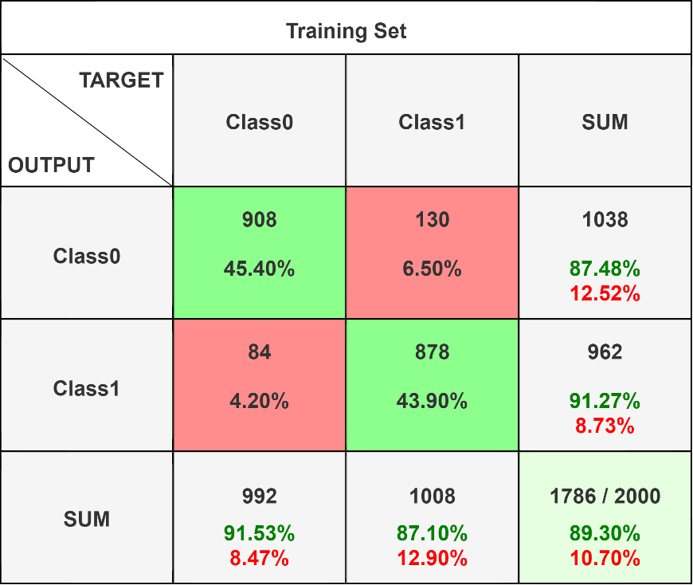
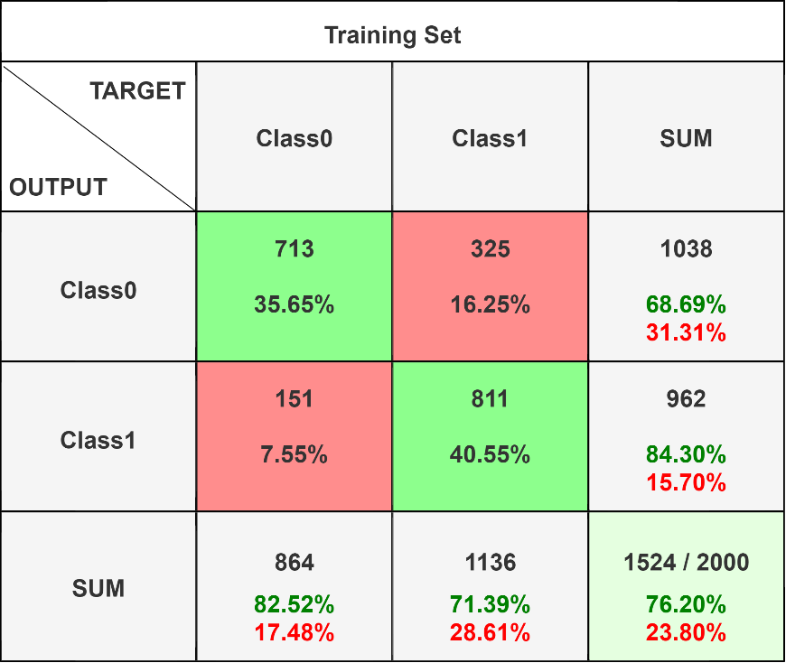
CONFUSION MATRIX
CONFUSION MATRIX OBTAINED BY SVM
CONFUSION MATRIX OBTAINED BY KNN
Accuracy : 89.30%
Accuracy : 76.20%
Classifying depression using machine learning on social media tweets

Slide 16
PERFOMANCE PARAMETERS
 | Precision | Recall | f1-score | Support
Class 1 | 0.86 | 0.88 | 0.87 | 1938
Class 2 | 0.89 | 0.87 | 0.88 | 2062
Accuracy |  |  | 0.88 | 4000
Macro Avg | 0.88 | 0.88 | 0.88 | 4000
Weighted Avg | 0.88 | 0.88 | 0.88 | 4000
SVM ACCURACY
 | precision | Recall | f1-score | Support
Class 1 | 0.64 | 0.78 | 0.70 | 1628
Class 2 | 0.82 | 0.70 | 0.76 | 2372
Accuracy |  |  | 0.73 | 4000
macro avg | 0.73 | 0.74 | 0.73 | 4000
weighted avg | 0.75 | 0.73 | 0.74 | 4000
KNN ACCURACY
Classifying depression using machine learning on social media tweets

Slide 17
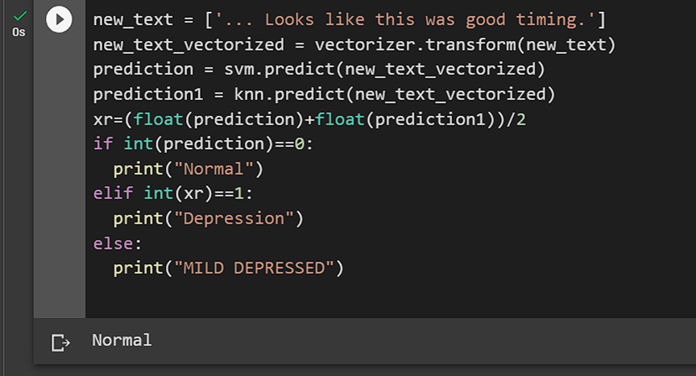
RESULT
A Normal text is given as input and output is obtained as Normal.
Output of Normal Prediction
Classifying depression using machine learning on social media tweets

Slide 18
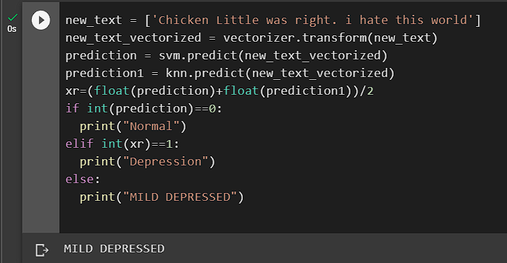
A Mild depressed text is given as input and output is obtained as Mild depressed.
Output of MILD DEPRESSED Prediction
Classifying depression using machine learning on social media tweets

Slide 19
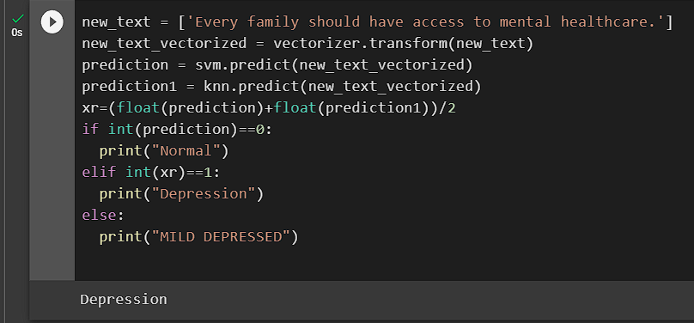
A Depressed text is given as input and output is obtained as Depressed.
Output of DEPRESSED Prediction
Classifying depression using machine learning on social media tweets

Slide 20
CONCLUSION
The proposed system can greatly enhance the management of mental health by predicting depression in modern living using social media tweets and SVM and KNN algorithms.
This technique showed us how important feature extraction and data preparation are to the model's performance.
Preprocessing and cleaning social media data are essential for ensuring the accuracy and reliability of machine learning models.
12/04/23
Classifying depression using machine learning on social media tweets

Slide 21
FUTURE SCOPE
Future studies may examine the application of machine learning to the classification of depression using multimodal data.
Customized screening and intervention can increase the accuracy and efficacy of screening and intervention by adapting machine learning models for depression categorization to the profiles and preferences of specific users.
Future studies can examine the clinical uses of machine learning models for social media depression classification.
12/04/23
Classifying depression using machine learning on social media tweets

Slide 22
PUBLICATION
Title : Classifying depression using machine learning on social media tweets
Authors Details: Ms. Biji Rose, Bipin V K, Cris Cumins P, Wilson A
Conference / Journal : International Conference on Network, Multimedia and Information Technology
Scopus Detail: Yes (IEEE)
Month & Year of Publication : September 01-02, 2023
12/04/23
Classifying depression using machine learning on social media tweets

Slide 23
REFERENCES
[1]. M. Rizwan, M. F. Mushtaq, U. Akram, A. Mehmood, I. Ashraf and B. Sahelices, "Depression Classification From Tweets Using Small Deep Transfer Learning Language Models," in IEEE Access, vol. 10, pp. 129176-129189, 2022, doi: 10.1109/ACCESS.2022.3223049.
[2]. J. Zhou, H. Zogan, S. Yang, S. Jameel, G. Xu and F. Chen, "Detecting Community Depression Dynamics Due to COVID-19 Pandemic in Australia," in IEEE Transactions on Computational Social Systems, vol. 8, no. 4, pp. 982-991, Aug. 2021, doi: 10.1109/TCSS.2020.3047604.
[3]. R. S. Jagdale and S. S. Deshmukh, "Sentiment Classification on Twitter and Zomato Dataset Using Supervised Learning Algorithms," 2020 International Conference on Smart Innovations in Design, Environment, Management, Planning and Computing (ICSIDEMPC), Aurangabad, India, 2020, pp. 330-334, doi: 10.1109/ICSIDEMPC49020.2020.9299582.
[4]. R. S. Skaik and D. Inkpen, "Predicting Depression in Canada by Automatic Filling of Beck’s Depression Inventory Questionnaire," in IEEE Access, vol. 10, pp. 102033-102047, 2022, doi: 10.1109/ACCESS.2022.3208470.
12/04/23
Classifying depression using machine learning on social media tweets

Slide 24
REFERENCES
[5]. Safa, R., Bayat, P. & Moghtader, L. Automatic detection of depression symptoms in twitter using multimodal analysis. J Supercomput 78, 4709–4744 (2022).
[6]. Sonam Gupta, Lipika Goel, Arjun Singh, Ajay Prasad, Mohammad Aman Ullah, "Psychological Analysis for Depression Detection from Social Networking Sites", Computational Intelligence and Neuroscience, vol. 2022, Article ID 4395358, 14 pages, 2022. https://doi.org/10.1155/2022/4395358
[7]. M. M. Tadesse, H. Lin, B. Xu and L. Yang, "Detection of Depression-Related Posts in Reddit Social Media Forum," in IEEE Access, vol. 7, pp. 44883-44893, 2019, doi: 10.1109/ACCESS.2019.2909180.
[8]. Mohammed Hasan Ali Al-Abyadh, Mohamed A. M. Iesa, Hani Abdel Hafeez Abdel Azeem, Devesh Pratap Singh, Pardeep Kumar, Mohamed Abdulamir, Asadullah Jalali, "Deep Sentiment Analysis of Twitter Data Using a Hybrid Ghost Convolution Neural Network Model", Computational Intelligence and Neuroscience, vol. 2022, Article ID 6595799, 8 pages, 2022.
[9]. H. T. Phan, V. C. Tran, N. T. Nguyen and D. Hwang, "Improving the Performance of Sentiment Analysis of Tweets Containing Fuzzy Sentiment Using the Feature Ensemble Model," in IEEE Access, vol. 8, pp. 14630-14641, 2020, doi: 10.1109/ACCESS.2019.2963702.
12/04/23
Classifying depression using machine learning on social media tweets

Slide 25
REFERENCES
[10]. Jiang C, Li Y, Tang Y, Guan C. Enhancing EEG-Based Classification of Depression Patients Using Spatial Information. IEEE Trans Neural Syst Rehabil Eng. 2021:29:566-575. doi: 10.1109/TNSRE.2021.3059429. Epub 2021 Mar 3. PMID: 33587703.
[11]. Sonam Gupta, Lipika Goel, Arjun Singh, Ajay Prasad, Mohammad Aman Ullah, "Psychological Analysis for Depression Detection from Social Networking Sites", Computational Intelligence and Neuroscience, vol. 2022, Article ID 4395358, 14 pages, 2022.
[12]. Khatua, Aparup & Cambria, Erik & Ghosh, Kuntal & Chaki, Nabendu & Khatua, Apalak. (2019). Tweeting in Support of LGBT?: A Deep Learning Approach. 342-345. 10.1145/3297001.3297057.
[13]. Angskun, J., Tipprasert, S. & Angskun, T. Big data analytics on social networks for real-time depression detection. J Big Data 9, 69 (2022).
[14]. Kayıkçı, Ş. SenDemonNet: sentiment analysis for demonetization tweets using heuristic deep neural network. Multimed Tools Appl 81, 11341–11378 (2022).
12/04/23
Classifying depression using machine learning on social media tweets

Slide 26
THANK YOU
12/04/23
Classifying depression using machine learning on social media tweets

